Slide 1
Lecture 3
Signals and Systems (ELL205)
By Dr. Abhishek Dixit
Dept. of Electrical Engineering
IIT Delhi

Slide 2
Outline
Different kinds of Signals
  Continuous-time vs. Discrete-time signals
  Energy vs. Power signals
Signal transformations
  Flipping
  Scaling
  Shifting
Further classifications of Signals
  Even vs. Odd signals
  Periodic vs. Aperiodic signals
Basic Signals
  Exponential

Slide 3
Outline
Different kinds of Signals
  Continuous-time vs. Discrete-time signals
  Energy vs. Power signals
Signal transformations
  Flipping
  Scaling
  Shifting
Further classifications of Signals
  Even vs. Odd signals
  Periodic vs. Aperiodic signals
Basic Signals
  Exponential

Slide 4


Transformation of DT signal
$$x\left[n\right]=\{−5,3,2,1,4,5\}$$
$$n=0$$

Slide 5

Transformation of DT signal
$$x\left[n\right]=\{−5,3,2,1,4,5\}$$
$$x\left[−n\right]=$$
$$n=0$$

Slide 6


Transformation of DT signal
$$x\left[−n\right]=\{5,4,1,2,3,−5\}$$
$$n=0$$
$$n=0$$
$$x\left[n\right]=\{−5,3,2,1,4,5\}$$

Slide 7


Transformation of DT signal
$$x\left[n\right]=\{−5,3,2,1,4,5\}$$
$$x\left[−n\right]=\{5,4,1,2,3,−5\}$$
$$n=0$$
$$n=0$$
$$x\left[n+2\right]=\{−5,3,2,1,4,5\}$$
$$n=0$$
$$x\left[n−2\right]=\{−5,3,2,1,4,5\}$$
$$n=0$$

Slide 8

Transformation of DT signal
$$x\left[n\right]=\{−5,3,2,1,4,5\}$$
$$n=0$$
$$y\left[n\right]=x[2n]$$

Slide 9





Transformation of DT signal
$$x\left[n\right]=\{−5,3,2,1,4,5\}$$
$$n=0$$
$$y\left[n\right]=x[2n]$$
$$y\left[−2\right]=x\left[−4\right]=0$$
$$y\left[−1\right]=x\left[−2\right]=−5$$
$$y\left[0\right]=x\left[0\right]=2$$
$$y\left[1\right]=x\left[2\right]=4$$
$$y\left[2\right]=x\left[4\right]=0$$

Slide 10


Transformation of DT signal
$$x\left[n\right]=\{−5,3,2,1,4,5\}$$
$$n=0$$
$$y\left[n\right]=x[2n]$$
$$y\left[n\right]=\{0,−5,2,4,0\}$$
$$y\left[−2\right]=x\left[−4\right]=0$$
$$n=0$$
$$y\left[−1\right]=x\left[−2\right]=−5$$
$$y\left[0\right]=x\left[0\right]=2$$
$$y\left[1\right]=x\left[2\right]=4$$
$$y\left[2\right]=x\left[4\right]=0$$

Slide 11
Transformation of DT signal
$$x\left[n\right]=\{−5,3,2,1,4,5\}$$
$$n=0$$
$$y\left[n\right]=x[2n]$$
$$y\left[n\right]=\{0,−5,2,4,0\}$$
$$y\left[−2\right]=x\left[−4\right]=0$$
$$n=0$$
$$y\left[−1\right]=x\left[−2\right]=−5$$
Leads to decimation of samples (samples are permanently lost)
$$y\left[0\right]=x\left[0\right]=2$$
$$y\left[1\right]=x\left[2\right]=4$$
$$y\left[2\right]=x\left[4\right]=0$$

Slide 12
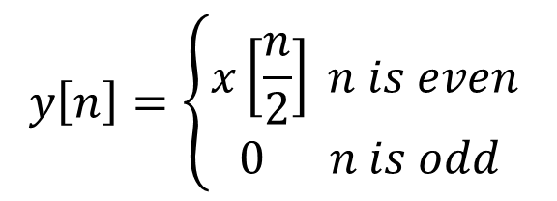
Transformation of DT signal
$$x\left[n\right]=\{−5,3,2,1,4,5\}$$
$$n=0$$
$$y\left[n\right]=\left\{\begin{aligned}x\left[\frac{n}{2}\right] n is even \\ 0 n is odd\end{aligned}\right.$$

Slide 13

Transformation of DT signal
$$x\left[n\right]=\{−5,3,2,1,4,5\}$$
$$n=0$$
$$y\left[n\right]=\left\{\begin{aligned}x\left[\frac{n}{2}\right] n is even \\ 0 n is odd\end{aligned}\right.$$
$$y\left[n\right]=\{0,−5,0,3,0,2,0,1,0,4,0,5,0\}$$
$$n=0$$

Slide 14
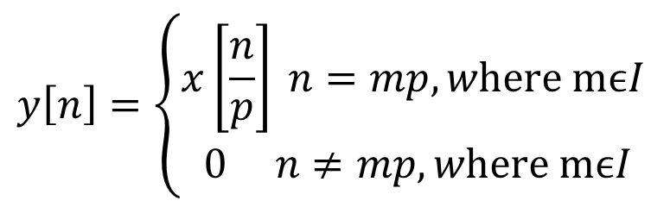

Transformation of DT signal
$$x\left[n\right]=\{−5,3,2,1,4,5\}$$
$$n=0$$
$$y\left[n\right]=\{0,−5,0,3,0,2,0,1,0,4,0,5,0\}$$
$$y\left[n\right]=\left\{\begin{aligned}x\left[\frac{n}{2}\right] n is even \\ 0 n is odd\end{aligned}\right.$$
$$n=0$$
$$y\left[n\right]=\left\{\begin{aligned}x\left[\frac{n}{p}\right] n=mp, w\text{here} \text{m}ϵI \\ 0 n≠mp, w\text{here} \text{m}ϵI\end{aligned}\right.$$
If $p>1 \& an I$, then insert $p−1$ zeros between samples.

Slide 15
Outline
Different kinds of Signals
  Continuous-time vs. Discrete-time signals
  Energy vs. Power signals
Signal transformations
  Flipping
  Scaling
  Shifting
Further classifications of Signals
  Even vs. Odd signals
  Periodic vs. Aperiodic signals
Basic Signals
  Exponential

Slide 16
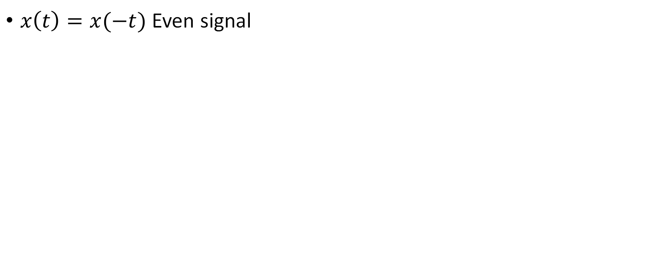
Even vs. Odd signals
$x\left(t\right)=x(−t)$ Even signal

Slide 17


Even vs. Odd signals
$x\left(t\right)=x(−t)$ Even signal
$$x(t)$$
-1 0 1
$$t$$

Slide 18

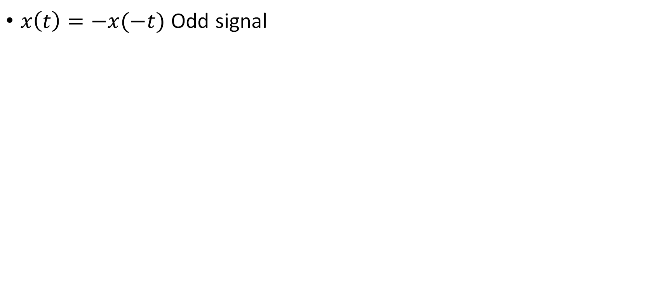

Even vs. Odd signals
$x\left(t\right)=−x(−t)$ Odd signal
$$x(t)$$
-3 -2 0 2 3
$$t$$

Slide 19

Even vs. Odd signals
$$x(t)$$
$x\left(t\right)=−x(−t)$ Odd signal
-3 -2 0 2 3
$$t$$
$$x(t)$$
$$x(−t)$$
-3 -2 0 2 3
-3 -2 0 2 3
$$t$$
$$t$$

Slide 20
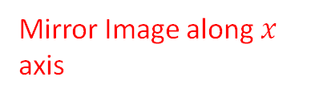
Even vs. Odd signals
$$x(t)$$
$x\left(t\right)=−x(−t)$ Odd signal
-3 -2 0 2 3
$$t$$
$$x(t)$$
$$x(−t)$$
Mirror Image along $x$ axis
-3 -2 0 2 3
-3 -2 0 2 3
$$t$$
$$t$$

Slide 21


Even vs. Odd signals
$x\left(t\right)=−x(−t)$ Odd signal
For odd signal
$$x\left(0\right)=−x(0)$$
$$x(t)$$
$$x\left(0\right)=0$$
-3 -2 0 2 3
$$t$$

Slide 22
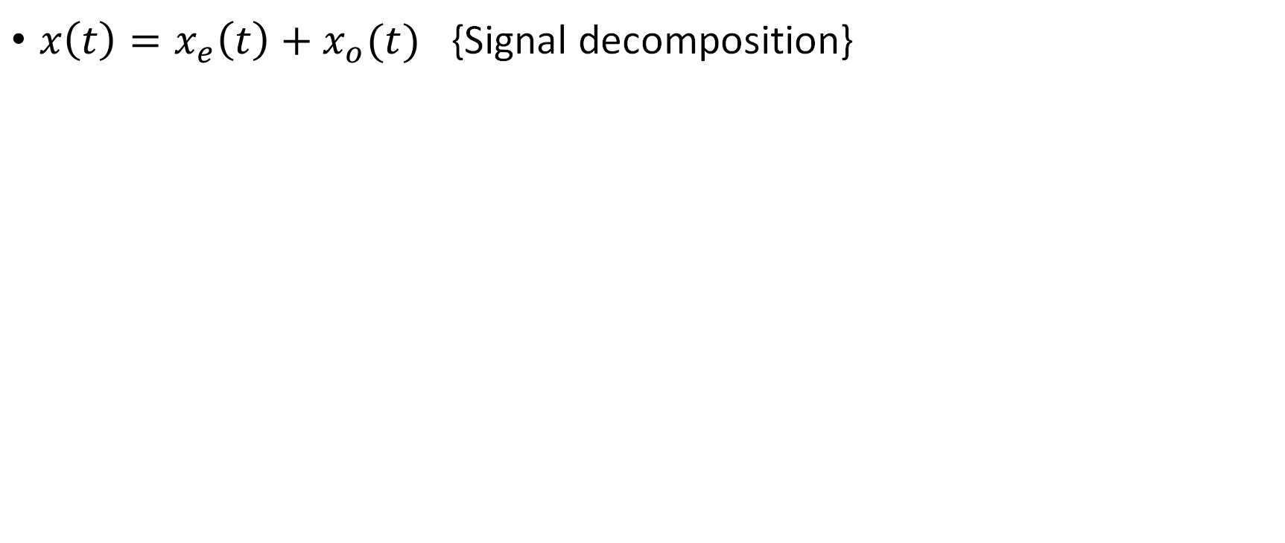
Even vs. Odd signals
$x\left(t\right)=x_{e}\left(t\right)+x_{o}(t)$ {Signal decomposition}

Slide 23
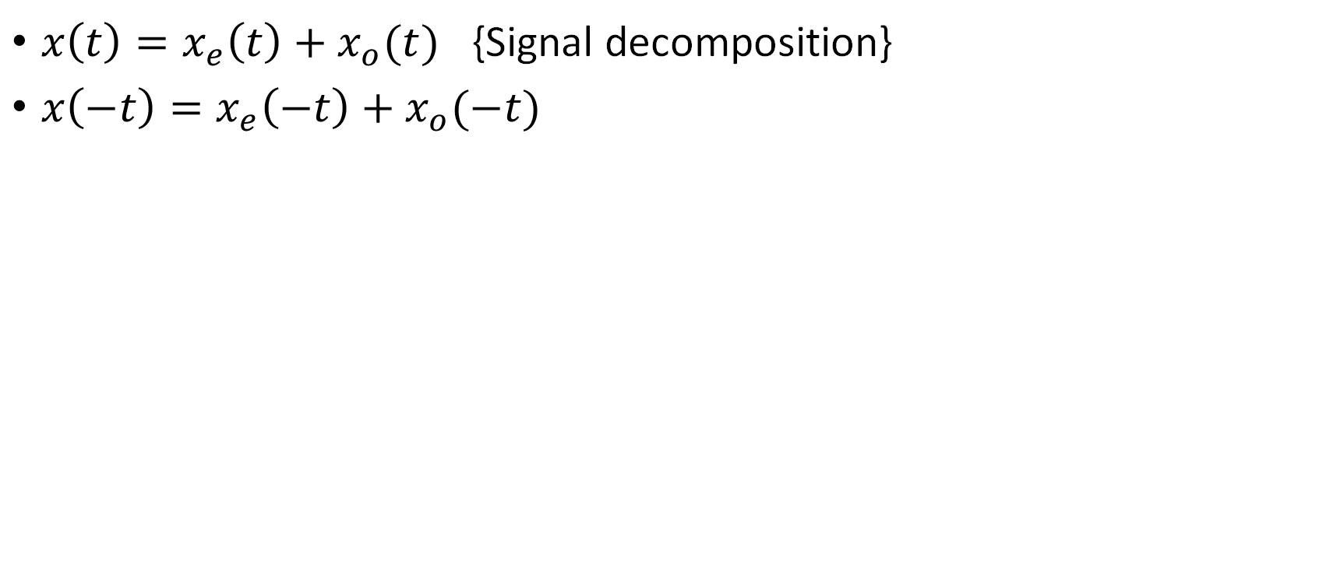
Even vs. Odd signals
$x\left(t\right)=x_{e}\left(t\right)+x_{o}(t)$ {Signal decomposition}
$x\left(−t\right)=x_{e}\left(−t\right)+x_{o}(−t)$

Slide 24
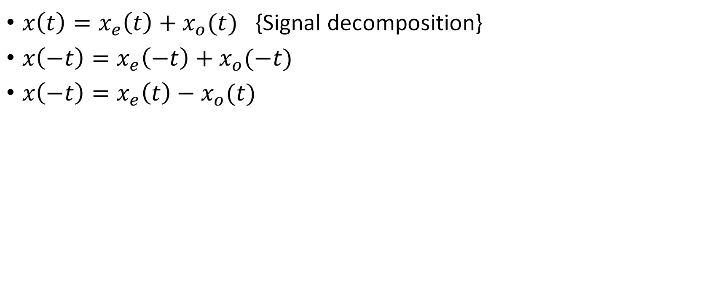
Even vs. Odd signals
$x\left(t\right)=x_{e}\left(t\right)+x_{o}(t)$ {Signal decomposition}
$x\left(−t\right)=x_{e}\left(−t\right)+x_{o}(−t)$
$x\left(−t\right)=x_{e}\left(t\right)−x_{o}(t)$

Slide 25
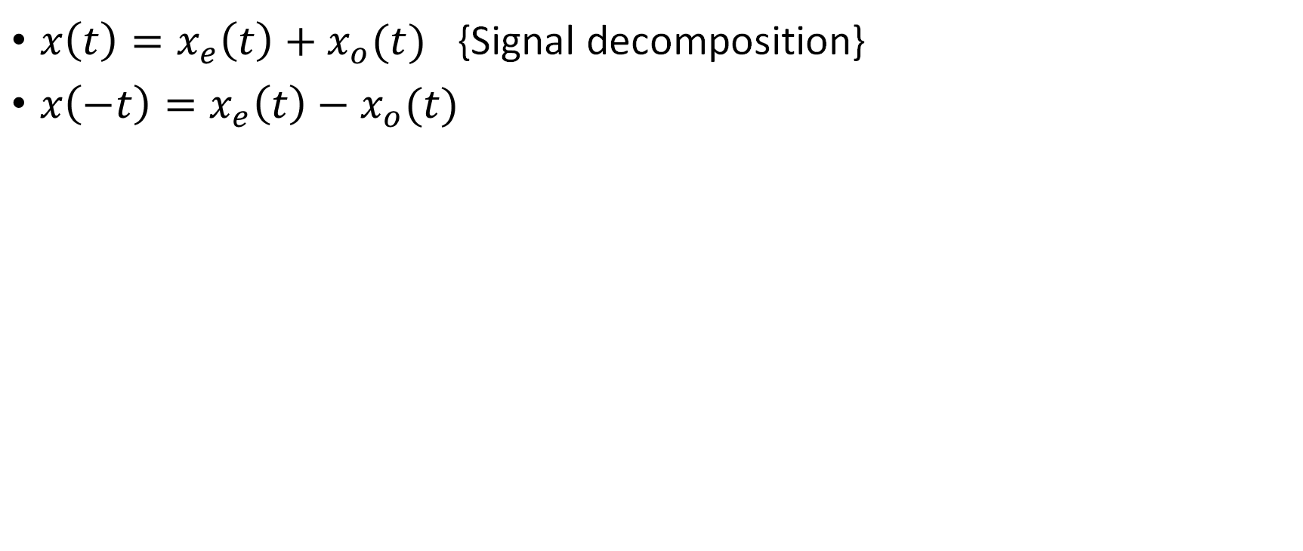
Even vs. Odd signals
$x\left(t\right)=x_{e}\left(t\right)+x_{o}(t)$ {Signal decomposition}
$x\left(−t\right)=x_{e}\left(t\right)−x_{o}(t)$

Slide 26
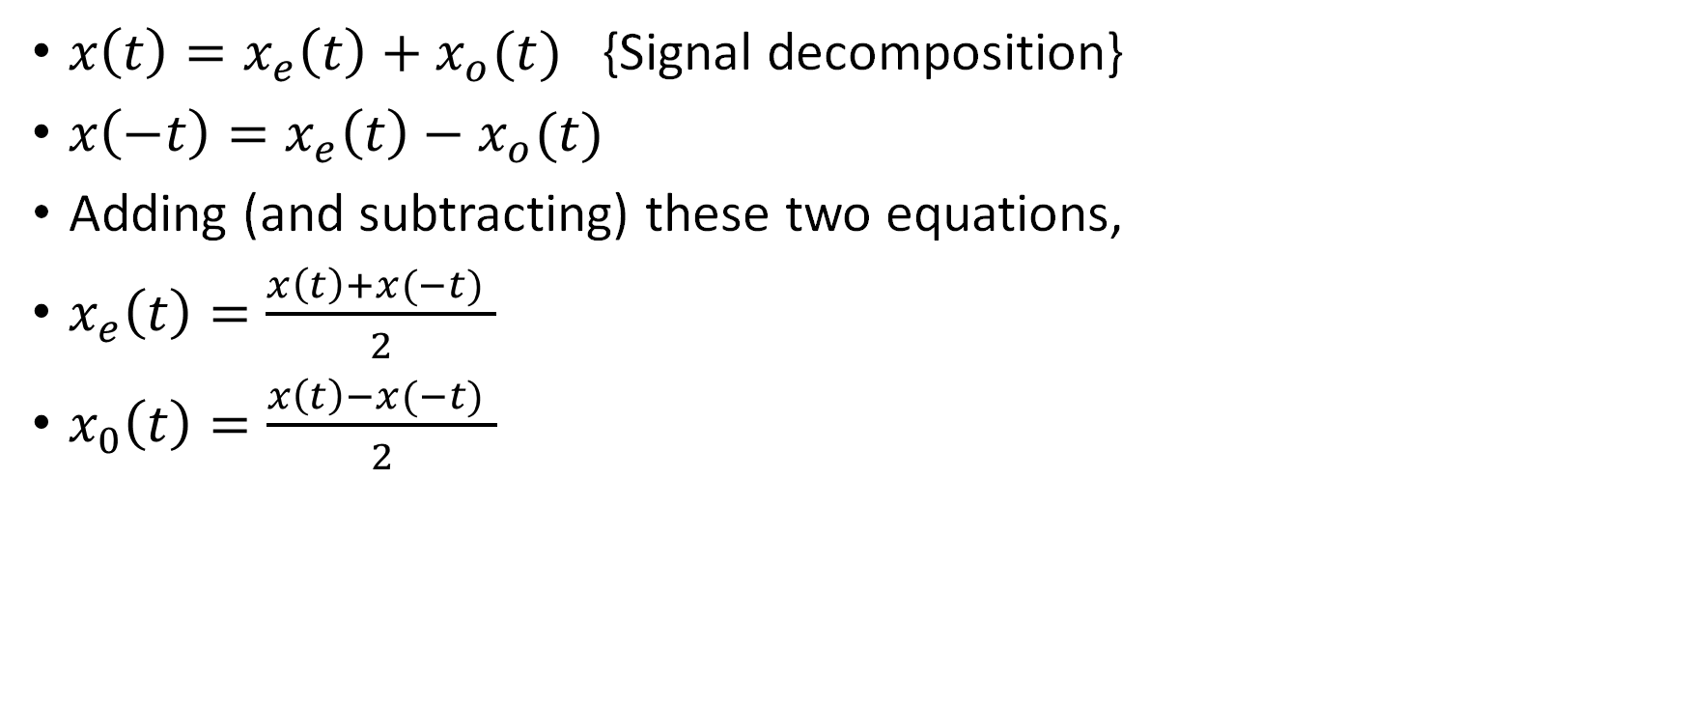
Even vs. Odd signals
$x\left(t\right)=x_{e}\left(t\right)+x_{o}(t)$ {Signal decomposition}
$x\left(−t\right)=x_{e}\left(t\right)−x_{o}(t)$
Adding (and subtracting) these two equations,
$x_{e}\left(t\right)=\frac{x\left(t\right)+x(−t) }{2}$
$x_{0}\left(t\right)=\frac{x\left(t\right)−x(−t) }{2}$

Slide 27
Outline
Different kinds of Signals
  Continuous-time vs. Discrete-time signals
  Energy vs. Power signals
Signal transformations
  Flipping
  Scaling
  Shifting
Further classifications of Signals
  Even vs. Odd signals
  Periodic vs. Aperiodic signals
Basic Signals
  Exponential

Slide 28
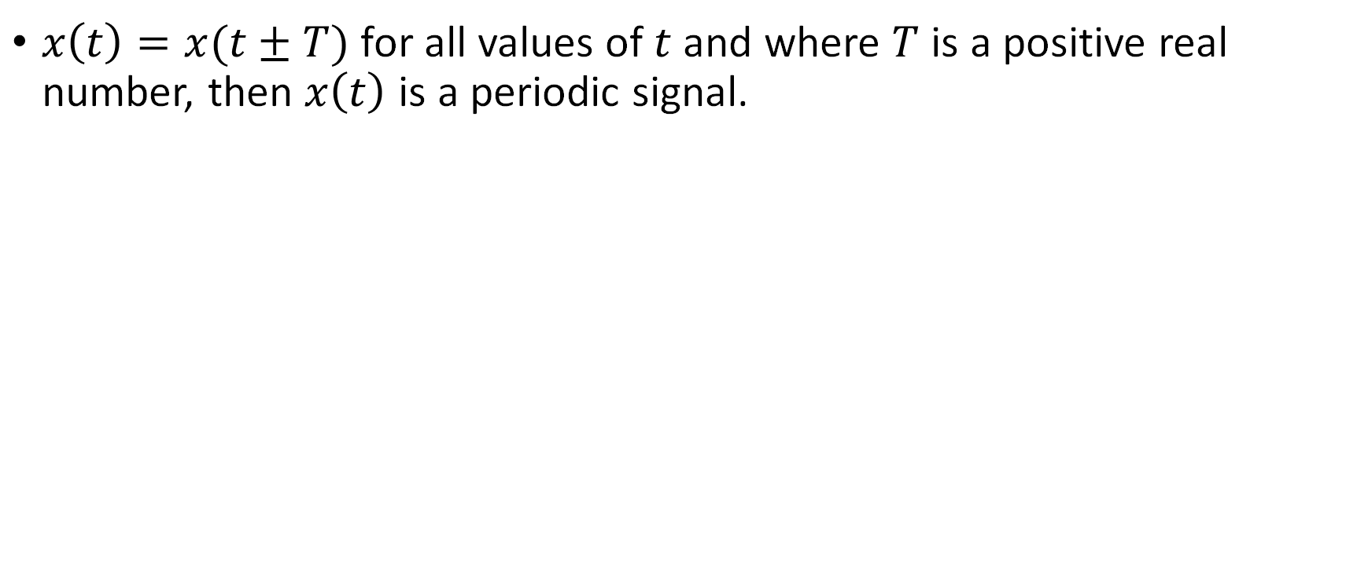
Periodic vs. Aperiodic signals
$x\left(t\right)=x(t±T)$ for all values of $t$ and where $T$ is a positive real number, then $x\left(t\right)$ is a periodic signal.

Slide 29
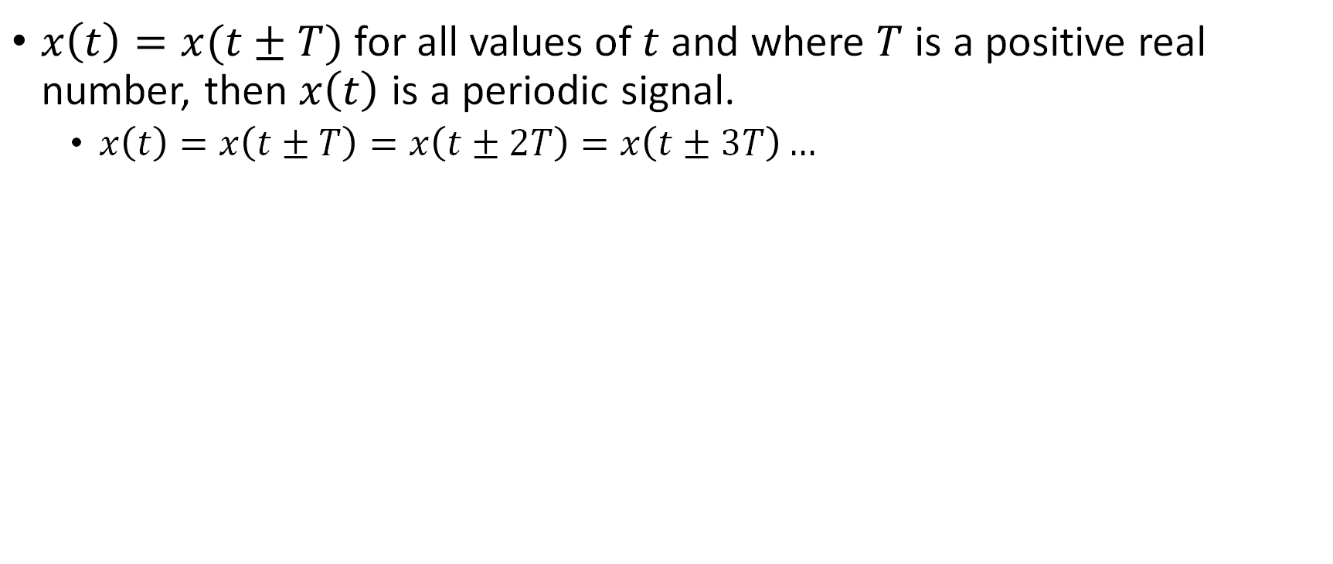
Periodic vs. Aperiodic signals
$x\left(t\right)=x(t±T)$ for all values of $t$ and where $T$ is a positive real number, then $x\left(t\right)$ is a periodic signal.
  $x\left(t\right)=x\left(t±T\right)=x\left(t±2T\right)=x\left(t±3T\right)…$

Slide 30
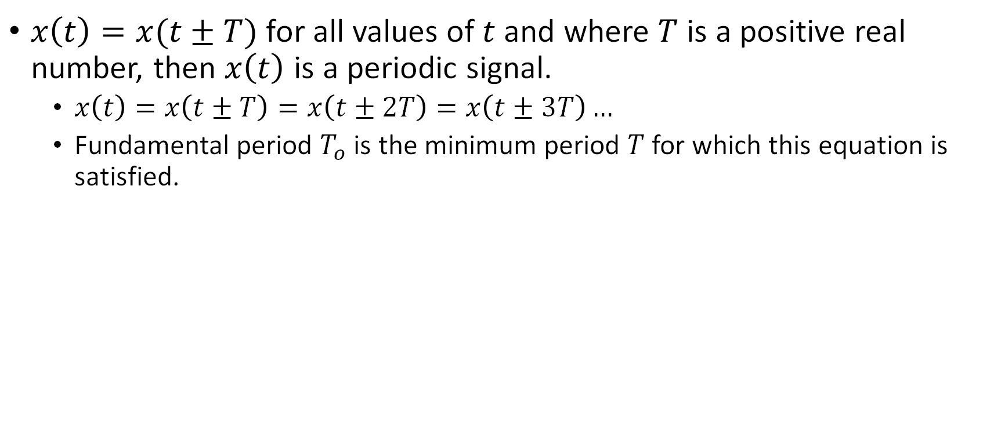
Periodic vs. Aperiodic signals
$x\left(t\right)=x(t±T)$ for all values of $t$ and where $T$ is a positive real number, then $x\left(t\right)$ is a periodic signal.
  $x\left(t\right)=x\left(t±T\right)=x\left(t±2T\right)=x\left(t±3T\right)…$
  Fundamental period $T_{o}$ is the minimum period $T$ for which this equation is satisfied.

Slide 31
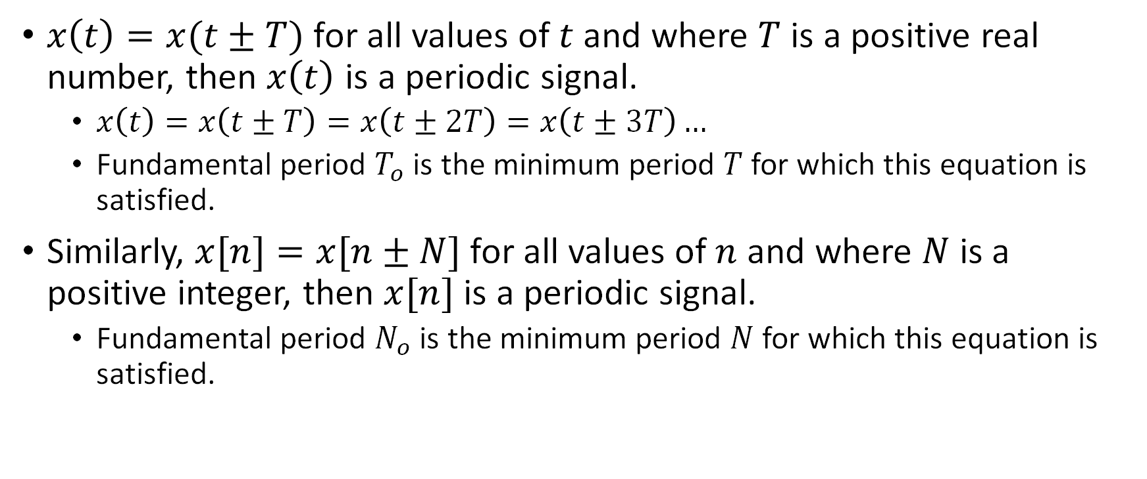
Periodic vs. Aperiodic signals
$x\left(t\right)=x(t±T)$ for all values of $t$ and where $T$ is a positive real number, then $x\left(t\right)$ is a periodic signal.
  $x\left(t\right)=x\left(t±T\right)=x\left(t±2T\right)=x\left(t±3T\right)…$
  Fundamental period $T_{o}$ is the minimum period $T$ for which this equation is satisfied.
Similarly, $x[n]=x[n±N]$ for all values of $n$ and where $N$ is a positive integer, then $x[n]$ is a periodic signal.
  Fundamental period $N_{o}$ is the minimum period $N$ for which this equation is satisfied.

Slide 32
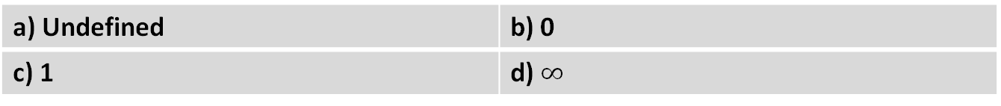
Periodic vs. Aperiodic signals
Fundamental period of $x(t)$?
$$x(t)$$
$$t$$
a) Undefined | b) 0
c) 1 | d) $∞$

Slide 33
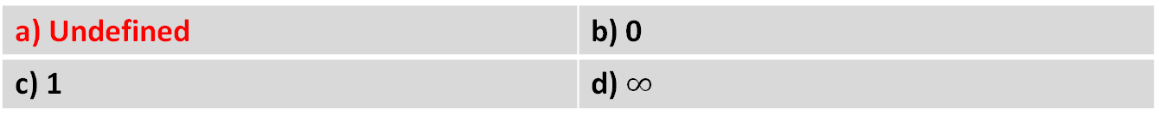
Periodic vs. Aperiodic signals
Fundamental period of $x(t)$?
$$x(t)$$
$$t$$
a) Undefined | b) 0
c) 1 | d) $∞$

Slide 34
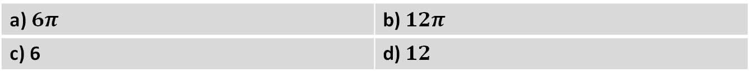
Periodic vs. Aperiodic signals
Fundamental period of cos$(t/6)$?
a) $6π$ | b) $12π$
c) 6 | d) $12$

Slide 35
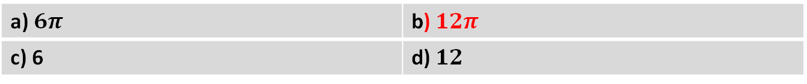

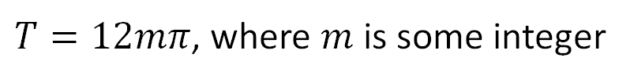
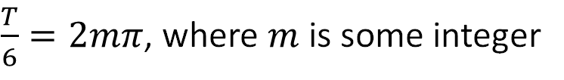
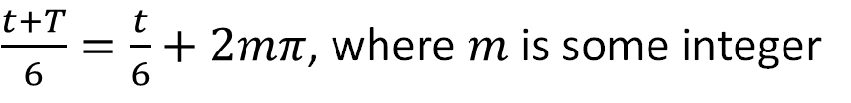
Periodic vs. Aperiodic signals
Fundamental period of cos$(t/6)$?
$\frac{t+T}{6}=\frac{t}{6}+2mπ$, where $m$ is some integer
$\frac{T}{6}=2mπ$, where $m$ is some integer
$T=12mπ$, where $m$ is some integer
$$T_{0}=12π$$
a) $6π$ | b) $12π$
c) 6 | d) $12$

Slide 36
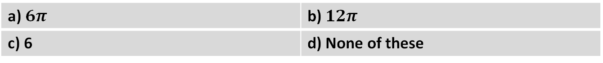
Periodic vs. Aperiodic signals
Fundamental period of $cos⁡[n/6]$?
a) $6π$ | b) $12π$
c) 6 | d) None of these

Slide 37
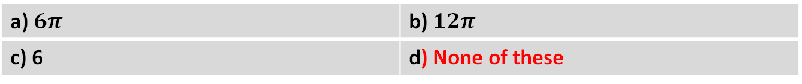
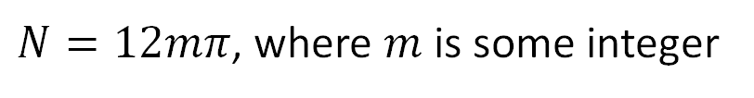
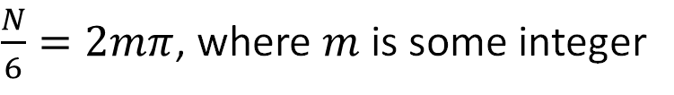
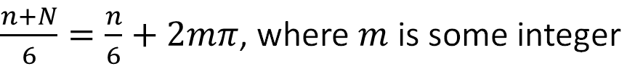
Periodic vs. Aperiodic signals
Fundamental period of $cos⁡[n/6]$?
$\frac{n+N}{6}=\frac{n}{6}+2mπ$, where $m$ is some integer
$\frac{N}{6}=2mπ$, where $m$ is some integer
$N=12mπ$, where $m$ is some integer
Thus, aperiodic
a) $6π$ | b) $12π$
c) 6 | d) None of these

Slide 38
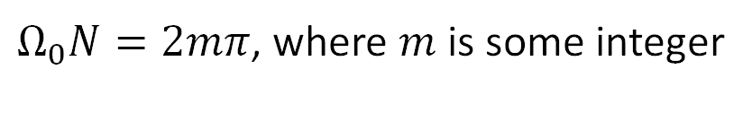
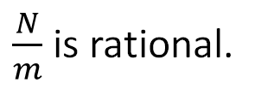
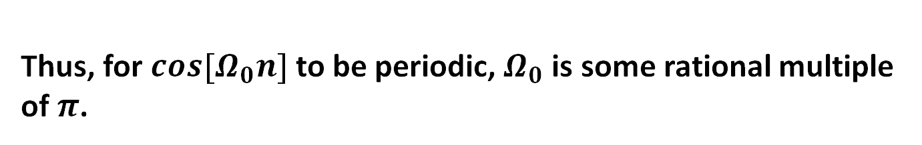
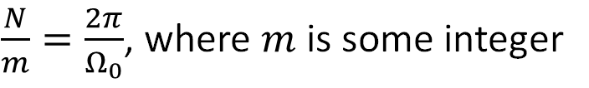
Periodic vs. Aperiodic signals
Fundamental period of $cos⁡[Ω_{0}n]$?
$Ω_{0}N=2mπ$, where $m$ is some integer
$\frac{N}{m}=\frac{2π}{Ω_{0}}$, where $m$ is some integer
$\frac{N}{m}$ is rational.
If $\frac{2π}{Ω_{0}}$ has to be rational, then $Ω_{0}$ is some rational multiple of $π$.
Thus, for $cos⁡[Ω_{0}n]$ to be periodic, $Ω_{0}$ is some rational multiple of $π$.

Slide 39
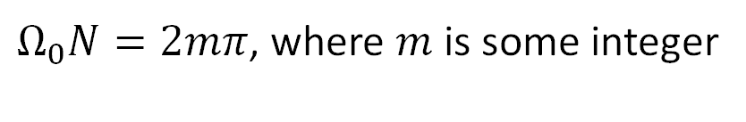
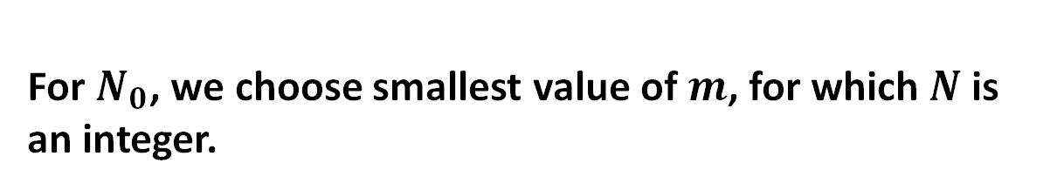
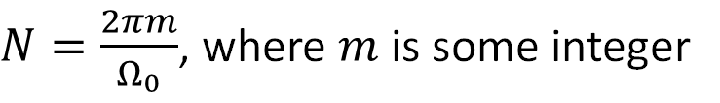
Periodic vs. Aperiodic signals
Fundamental period of $cos⁡[Ω_{0}n]$, if $Ω_{0}$ is some rational multiple of $π$?
$Ω_{0}N=2mπ$, where $m$ is some integer
$N=\frac{2πm}{Ω_{0}}$, where $m$ is some integer
For $N_{0}$, we choose smallest value of $m$, for which $N$ is an integer.

Slide 40
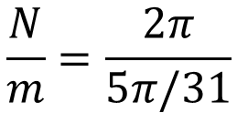
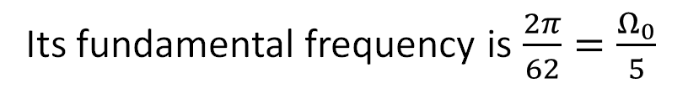

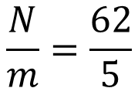
Periodic vs. Aperiodic signals
Fundamental period of $cos⁡[5πn/31]$?
$$\frac{N}{m}=\frac{2π}{5π/31}$$
$$\frac{N}{m}=\frac{62}{5}$$
$$N_{0}=62$$
Its fundamental frequency is $\frac{2π}{62}=\frac{Ω_{0}}{5}$

Slide 41
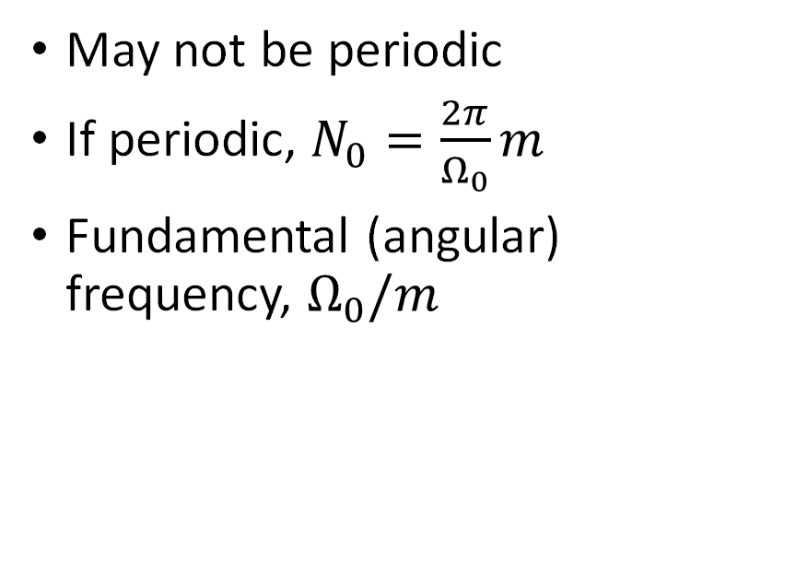
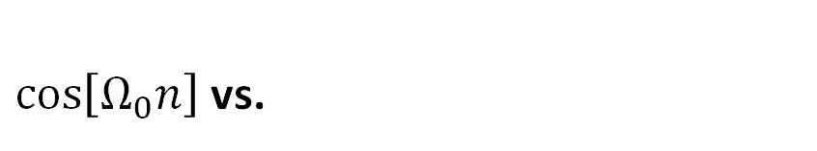
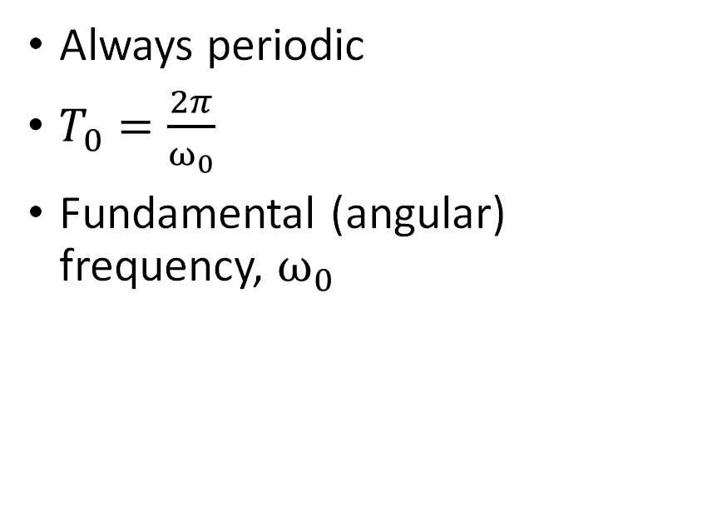

Periodic vs. Aperiodic signals
$\cos\left[Ω_{0}n\right]$ vs.
$$cos⁡(ω_{0}t)$$
May not be periodic
If periodic, $N_{0}=\frac{2π}{Ω_{0}}m$
Fundamental (angular) frequency, $Ω_{0}/m$
Always periodic
$T_{0}=\frac{2π}{ω_{0}}$
Fundamental (angular) frequency, $ω_{0}$

Slide 42
Outline
Different kinds of Signals
  Continuous-time vs. Discrete-time signals
  Energy vs. Power signals
Signal transformations
  Flipping
  Scaling
  Shifting
Further classifications of Signals
  Even vs. Odd signals
  Periodic vs. Aperiodic signals
Basic Signals
  Exponential

Slide 43

Exponential
$$Ce^{αt}$$

Slide 44
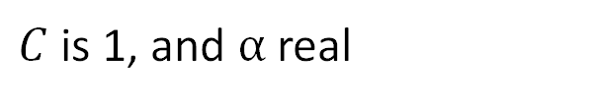
Exponential
$$Ce^{αt}$$
$C$ is 1, and $α$ real

Slide 45
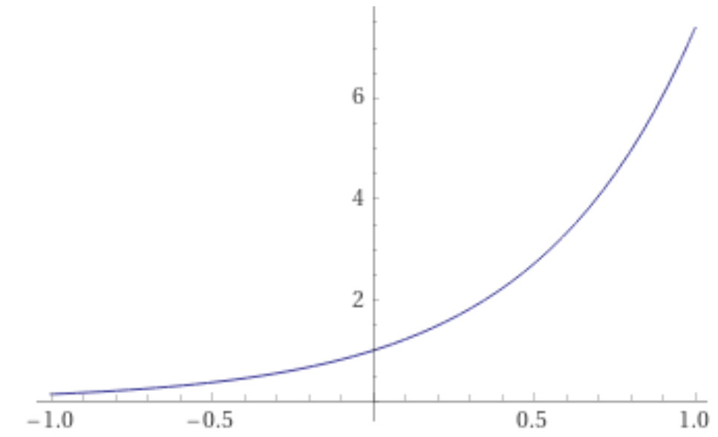
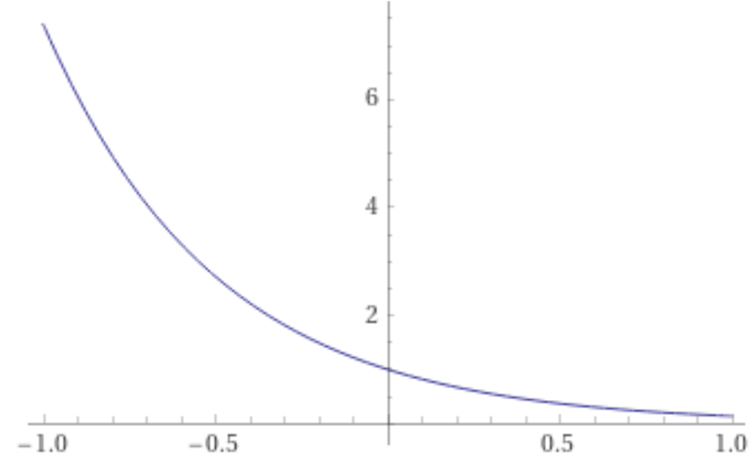



Exponential
$$Ce^{αt}$$
$C$ is 1, and $α$ real
$$α>0$$
$$α<0$$
$$t$$
$$t$$

Slide 46
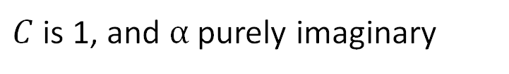




Exponential
$$Ce^{αt}$$
$C$ is 1, and $α$ purely imaginary
$$α=jω_{0}$$
$$j=\sqrt{−1}$$
$$Ce^{αt}=e^{jω_{0}t}$$

Slide 47

Exponential
$$Ce^{αt}$$
$C$ is 1, and $α$ purely imaginary
$$α=jω_{0}$$
$$j=\sqrt{−1}$$
$$Ce^{αt}=e^{jω_{0}t}=cosω_{0}t+jsinω_{0}t$$
Euler’s theorem

Slide 48
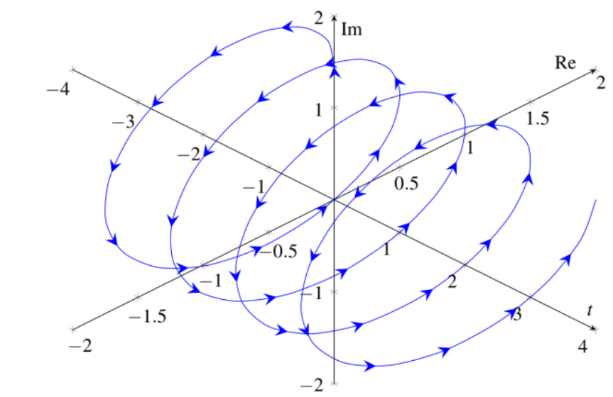

Exponential
$$Ce^{αt}$$
$C$ is 1, and $α$ purely imaginary
$$α=jω_{0}$$
$$j=\sqrt{−1}$$
$$Ce^{αt}=e^{jω_{0}t}=cosω_{0}t+jsinω_{0}t$$
Euler’s theorem

Slide 49

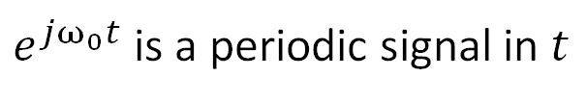
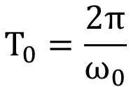
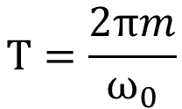

Exponential
$e^{jω_{0}t}$ is a periodic signal in $t$
$$e^{jω_{0}\left(t+T\right)}=e^{jω_{0}t}e^{j2πm}$$
1 (for $m$ an integer)
$$T=\frac{2πm}{ω_{0}}$$
$$T_{0}=\frac{2π}{ω_{0}}$$

Slide 50

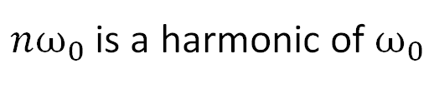


Exponential
$e^{jω_{0}t}$ is a periodic signal in $t$
$$x_{1}\left(t\right)=e^{jω_{0}t}$$
$$x_{2}\left(t\right)=e^{j{2ω}_{0}t}…$$
$$x_{n}\left(t\right)=e^{j{nω}_{0}t}$$
$nω_{0}$ is a harmonic of $ω_{0}$
A natural signal which contains “harmonics” of frequencies is a music signal.

